Slide 1
Page optimization and user engagement strategy analysis

Slide 2

Objective of the study
Our goal is to use the best search engine to reach the target population, who are primarily between the ages of 18 and 24, through the website we established specifically for this study. I carefully monitor and evaluate this website's performance utilizing the database I've gathered in order to improve website optimization and creativity.

Slide 3
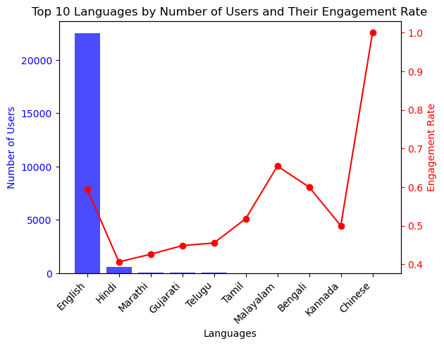
USER EXPERIENCE
From the study it is evident that the created site is easy to navigate across the information, Which are presented in all regional language across the country. Though the site has every other regional language the study shows that the engagement rate is high in English and Hindi comparatively and the design works properly and supports the user to complete their task in finer way.

Slide 4
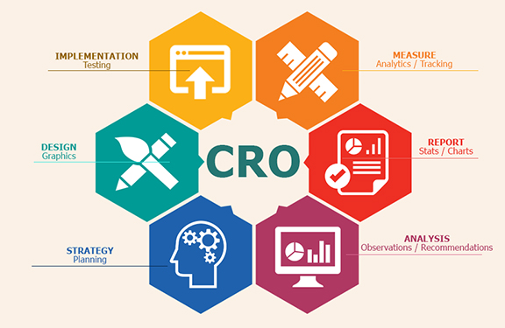
CONVERSION RATE OPTIMISATION (CRO)
The site to be loaded with facilities like Live chat , Active CTA buttons and testimonials to built trust among the users taken for the study. The data should be clearly analyzed through various forms such as Age, language, locality and channel group incorporating customer reviews. Mobile optimization of the site is highly recommended to achieve anticipated CRO

Slide 5
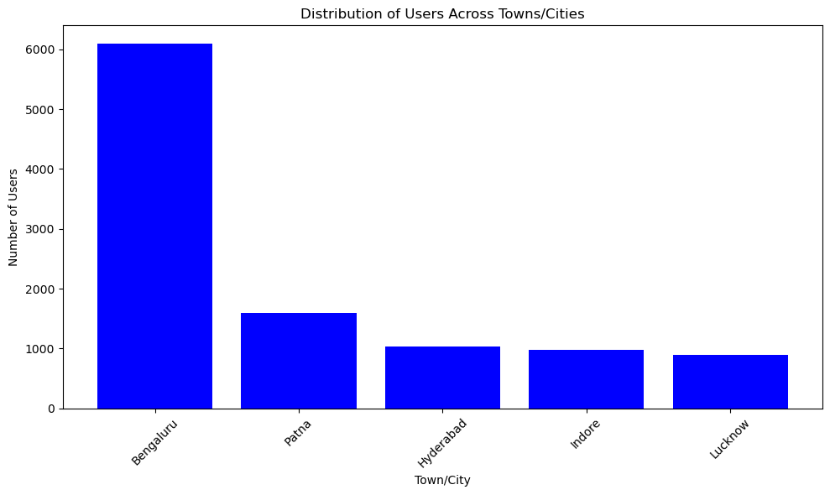
TARGET SPECIFIC CUSTOMER SEGMENT
Even though the site has customer segments across the country, the study shows that the majority of the users are from Bengaluru, Patna, Hyderabad, Indore, Lucknow. Which is clearly represented.

Slide 6
REVENUE GENERATION
Advertisement
Freemium
Models
Sponsorship
Partner with ad networks or affiliate platforms to display relevant ads or promote products/services
Offer a free version of your product or service with limited features
Collaborate with brands, influencers, or industry partners to sponsor content, events, or promotions on your website
Lead Magnet
lead magnets such as e-books, whitepapers, or webinars in exchange for contact information

Slide 7
AREA OF IMPROVEMENT
Regular promotional campaigns should be conducted
Improvement should be done in the area of Digital Marketing.
User installation should be increased with app store rating and reviews
Use push notifications to engage the users and keep them informed. about the content and updates.
Page optimization with clear navigating facilities of content and form can be enhanced.

Slide 8
RECOMENTATION
Target Specific Customer Segments:
Conduct data analysis to identify high-value customer segments based on demographics, behavior, and purchasing patterns.
Use customer segmentation to personalize marketing messages, product recommendations, and promotions for each segment.
Leverage customer relationship management (CRM) systems to track interactions and tailor communication based on individual preferences.
Modify Marketing Strategies:
Utilize data analytics tools to analyze the performance of past marketing campaigns and identify areas for improvement.
Experiment with different marketing channels, messaging, and ad formats to optimize campaign effectiveness.
Invest in targeted advertising campaigns that reach specific customer segments and drive qualified traffic to the app and website.

Slide 9
RECOMENTATION
Improve Product Offerings:
Gather feedback from customers through surveys, reviews, and user feedback forms to identify areas for product improvement.
Analyze user behavior and product usage data to understand feature preferences and pain points.
Continuously iterate on product development based on user feedback and market trends to enhance the user experience and meet evolving customer needs.
Optimize Website and App Pages:
Conduct usability testing and heatmaps analysis to identify areas of friction and optimize user flows on the website and app.
Implement responsive design principles to ensure seamless user experience across different devices and screen sizes.
Optimize landing pages, product pages, and checkout processes to minimize bounce rates and increase conversion rates.

Slide 10
RECOMENTATION
Increase User Installation and Engagement:
Implement app store optimization (ASO) techniques to improve visibility and ranking in app store search results.
Offer incentives such as discounts, promotions, or exclusive content to encourage app downloads and user registrations.
Leverage push notifications, in-app messaging, and personalized recommendations to re-engage users and drive ongoing app usage.
Enhance Customer Support and Engagement:
Provide multiple channels for customer support, including live chat, email, and phone support, to address user inquiries and resolve issues promptly.
Implement self-service options such as FAQ pages, knowledge bases, and tutorials to empower users to find answers to common questions independently.
Foster community engagement through user forums, social media groups, and online communities to encourage user interaction and peer support.

Slide 11
Summary
Page optimization involves improving various elements of a website or app to enhance user experience and drive desired actions, such as making a purchase or signing up for a service. This includes optimizing page load times, enhancing navigation, and streamlining the conversion process. By analyzing user behavior and conducting A/B testing, businesses can identify areas for improvement and implement strategies to increase conversions.
To get more user installations and engagement from the app and website, businesses should focus on effective marketing strategies, personalized messaging, and incentives to encourage users to download the app or visit the website. App store optimization (ASO) techniques can improve app visibility and ranking in app stores, while targeted advertising campaigns can drive qualified traffic to the app and website.
Once users have installed the app or visited the website, businesses should focus on engaging them through personalized content, push notifications, and interactive features. By offering incentives, rewards, and exclusive content, businesses can encourage ongoing app usage and repeat visits to the website. Additionally, providing excellent customer support and fostering community engagement can enhance user satisfaction and loyalty.

Slide 12
Thank you
ARAVIND RAJ M
aravindbe96@gmail.com
www.linkedin.com/in/aravind-raj-069800280

